Slide 1


Hii, Iam Siddhika
Welcome to Power BI Series
Part -12

Slide 2

Today Content
Are you ready guys?
continuing with
CREATING A DATA MODEL
ACTIVE & INACTIVE RELATIONSHIPS RELATIONSHIP CARDINALITY
ONE-TO-ONE ONE -TO-MANY MANY-TO-ONE MANY-TO-MANY

Slide 3
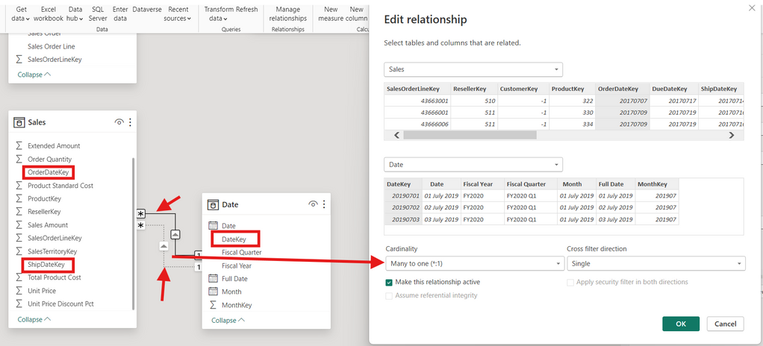

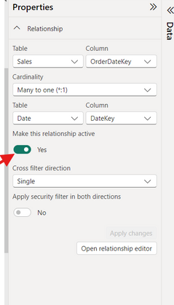
ACTIVE & INACTIVE RELATIONSHIPS
Have you got it?
The Sales Data table contains two date fields (OrderDateKey & ShipDateKey), but there can only be one active relationship to the DateKey in the Date table
You can set relationships to active or inactive from either the Edit Relationships dialog box or the Properties (you must deactivate one before activating another

Slide 4

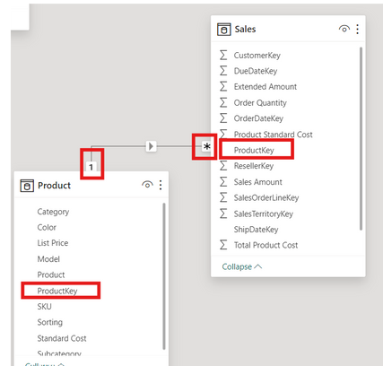
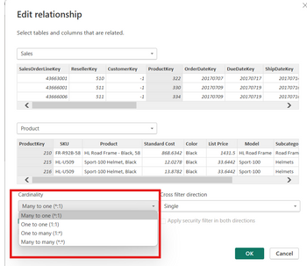
RELATIONSHIP CARDINALITY
Cardinality refers to the uniqueness of values in a column.
Ideally, all relationships in the data model should follow a
one-to-many cardinality: one instance of each primary key, and many instances of each foreign key.
In this example there is only ONE instance of each Product Key in the Product
table (noted by a “1”), since each row contains attributes of a single product
(name, SKU, description, price, etc.) There are MANY instances of each Product Key in the Sales table (noted by an
asterisk *), since there are multiple sales for each product
check this

Slide 5
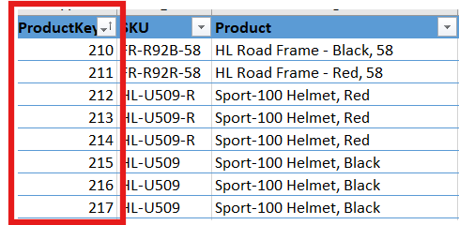
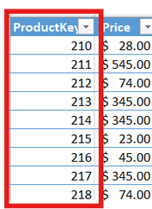

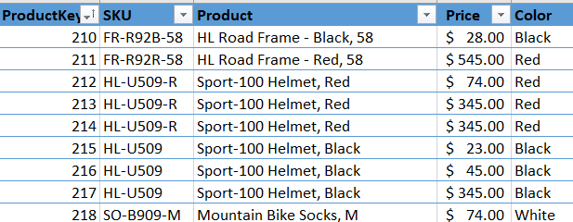
ONE-TO-ONE CARDINALITY
Product table
Price table
Connecting the two tables above using product_id creates a one-to- one relationship, since each product
ID only appears once in each table
Have you got it?
This isn’t necessarily a “bad” relationship, but you can simplify the model by merging the tables into a single, valid dimension table
NOTE: this still
respects the rules of normalization, since all rows are unique
and capture product- specific attributes

Slide 6
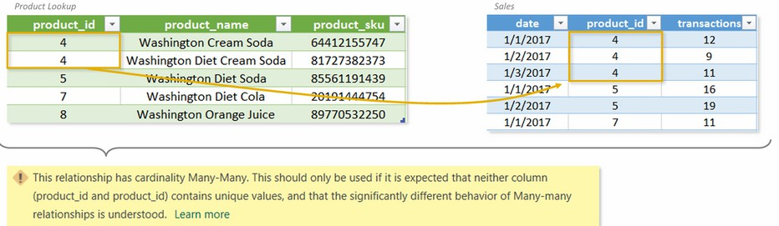

MANY-TO-MANY CARDINALITY
Which cardinality we should use?
If we try to connect the tables above using product_id, we’ll get a many-to-many relationship
warning since there are multiple instances of product_id in both tables.
Even if we force this relationship, how would we know which product was actually sold on each
date – Cream Soda or Diet Cream Soda?
In this situation, we should create a BRIDGE TABLE with unique values between this 2 tables

Slide 7

Thank you for joining me today to learn about Part -12 of Power BI!
Remember, mastering relationships in your data model is key to unlocking the full potential of Power BI for insightful reporting and visualization..
Stay tuned for more insights and tips on Power BI in our next Series.
Follow
Siddhika Shah

